Slide 1
YARN
Pravin Y Pawar

Slide 2
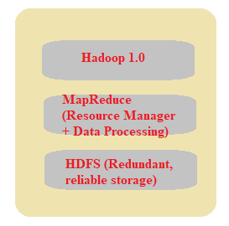
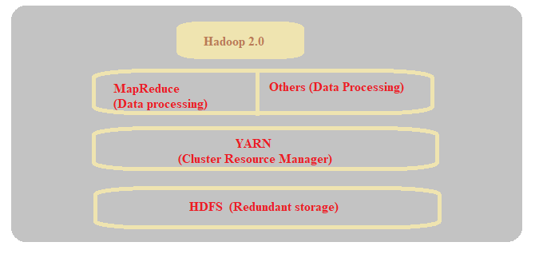
Yet Another Resource Manager (YARN)
Managing resources and applications with Hadoop YARN
Sub-project of Hadoop 2.x
Hadoop2.x is YARN based architecture
General data processing platform, not constrained to MapReduce
Can run multiple applications with commonly shared resource management
Can be used for processing like batch, interactive, streaming, graphs , machine learning etc.

Slide 3
YARN- Idea
Splitting the JobTracker responsibility of resource management and Job Scheduling / Monitoring into separate daemons
Daemons involved are :
A global resource manager
Scheduler
Application Manager
NodeManager
Per-Application ApplicationMaster
Application is job submitted to the framework – MapReduce Job
Container is basic unit of allocation , fine grained resource allocation across multiple resource types
Container 0 --- 2GB, 1 CPU
Container 1 --- 1 GB, 6 CPU
No fixed map/reduce slots

Slide 4
YARN Daemons
A Global ResourceManager
Main job is to distribute resources among various applications in the system
Scheduler
Pluggable component which decides allocation of resources to various running applications
Pure Scheduler – does not monitor or track the status of application
ApplicationManager
Accepts the job submissions
Negotiating resources (containers) for executing the ApplicationMaster
Restarting the ApplicationMaster in case of failure
NodeManager
Per machine slave daemon
Responsible for launching the application containers for app execution
Monitors the resource usage such as memory, CPU, disk etc
Reports the usage of resources to global ResourceManager
ApplicationMaster
Per application specific entity
Responsible for negotiating the resources for execution from ResourceManager
Works with NodeManager for executing and monitoring component tasks

Slide 5
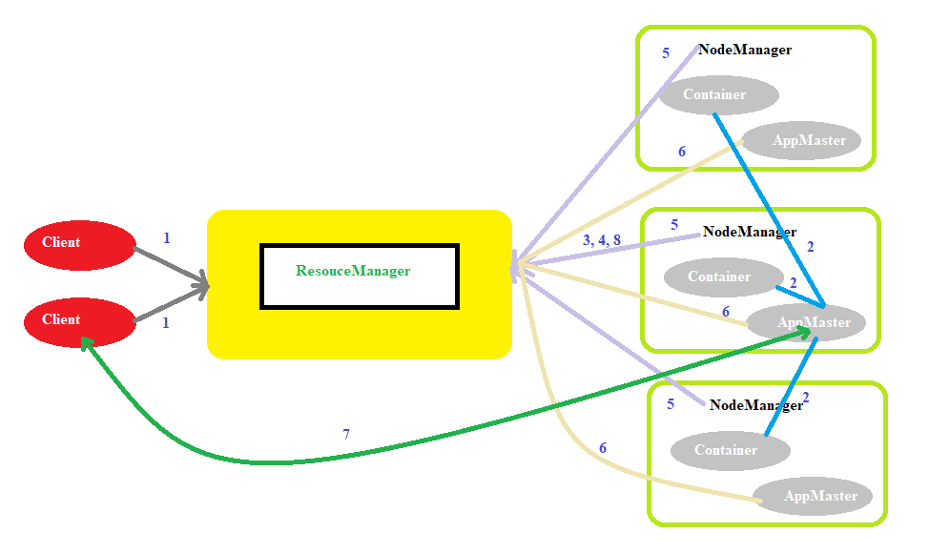
YARN Architecture

Slide 6
YARN Working
Client program submits application which includes necessary specifications to launch the app-specific ApplicationMaster itself
ResourceManager launches the ApplicationMaster by assigning some container
The ApplicationMaster, on boot-up, registers with ResourceManager. This helps client program to query ResourceManager directly for the details
During the normal course, ApplicationMaster negotiates appropriate resource containers via resource-request protocol
On successful container allocations, ApplicationMaster launches the container by providing container launch specification to NodeManager
NodeManager executes application code and provides necessary information such as progress, status to its ApplicationMaster via app-specific protocol
During the application execution, client that submitted the job directly communicates with the ApplicationMaster to get status, progress updates
Once the application has been processed completely, ApplicationMaster deregisters with the Resource Manager and shuts down, allowing its container to be repurposed.

Slide 7
Thank You!
Reference :
Big Data and Analytics by Acharya, Chellappan
In our next session:

